Slide 1
PMI Adelaide, South Australia Chapter
presents
How to Improve your Negotiation Skills
Wed 23/3/22
This event is sponsored by

Slide 2
Acknowledgment of the Land
We would like to acknowledge the Kaurna People of whose land we meet on today.
We also pay respects to their Elders past and present and extend that respect to other Aboriginal and Torrens Strait Islander people, if present, here today.

Slide 3
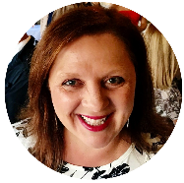
Agenda
Presentation open | 6.30pm
Introductions | 6:30pm to 6:40pm
Presentation | 6:40pm to 7.20pm
Q&A | 7.20pm to 7.30pm
Close | 7:30pm
AnnMarie Colangelo
Director of Events

Slide 4
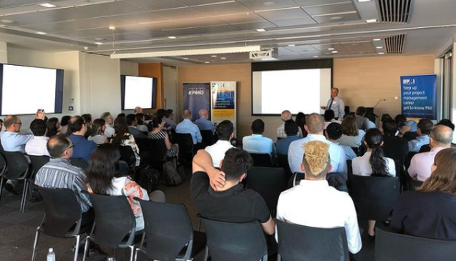
PMI Adelaide, SA Chapter
Run by volunteers, we provide the means for members to meet with peers from various industries and improve their project knowledge and skills through events, special workshops, marketing, newsletter publications
Established
2003
Members
+330
LinkedIn
+2200
Events
+12
Interested in becoming a Chapter volunteer visit our website https://pmiadelaide.org/membershipmenu/volunteering
4
Notes:
Run by volunteers, we provide the means for members to meet with peers from various industries and improve their project knowledge and skills through events, special workshops, marketing, newsletter publications and an annual project management conference.

Slide 5
Upcoming Events
Thursday 31/3/22 – Beer and Brains, Networking event
Wednesday 27/4/22 - When Projects hinge on mental health and stress management
Wednesday 23/5/22 – Beer and Brains, Networking event, Meet someone new
For more PMI Adelaide Chapter events visit our website - www.pmiadelaide.org
Interested in speaking at a PMI Adelaide Chapter event - events@pmiadelaide.org

Slide 6
Chapter Sponsors and Partners
Interested in becoming a Chapter partner or Sponsor - peterpavan@pmiadelaide.org

Slide 7
Event Sponsor – Paxus
Paxus is a leading technology and digital talent specialist, with a genuine dedication to candidate, contractor and client service. With operations spanning Australia, we connect thousands of talented people with great jobs every year, providing rewarding opportunities in the best organisations.
We partner with our clients across Australia to co-design creative and agile sourcing strategies, to attract skilled talent locally, and rare talent from across the globe. Candidates come to us because they know we will do everything we can to help them land their dream job - and our contractors are loyal because their dedicated Contractor Care Consultant makes doing business easy.
www.paxus.com.au

Slide 8
Think more, Do more, Feel more
Negotiation Skills
By Gina Brooks

Slide 9
Negotiation
‘To negotiate is to confer with another or others in order to come to terms or reach an agreement’
Notes:
2 mins. Get to know your partner
Find out what you agree on?
Debrief
What did you agree on?
If you have a shared purpose, not goal, but purpose you’re more likely to succeed in a

Slide 10
The Negotiation Process
Preparation
Opening Position
Bargaining
Movement
Closing
Notes:
Preparation:
Identify your key commitments
Opening Position:
Outline Your Opening Position
Decide whether this will be High Ball or Low Ball
Ensure that this position is realistic in light of the facts available to both sides
Allow for movement within whatever opening position you adopt
Confirm all agreements reached and positions offered
Bargaining
Question for Information
Challenge other side for justifications of their position
Examine and Test their commitment
Present Your Key Commitments
Explore Key Commitments
Summarise Arguments and Seek Acceptance
Look for Signals of Possible Movement
Identify and Highlight Common Ground
Movement
Be Prepared to Concede
Begin with those of Low Priority and seek High Priority Items
Never Concede on More than possible by your Brief
Use your Concessions Wisely
Don’t just give these away expect and receive something in return
Use Conditional Argument
All Movement Should be realistic and contained within your brief
It Should be always towards the other sides position and not away from it
Be prepared for larger movements at first as it can build trust within the negotiation
Continue with smaller movements
Closing
Emphasise the benefits to both parties
Carefully introduce the consequences of not reaching agreement to both parties and losing what has been agreed so far
Timing is Essential
Take Care when making a Final Offer. Be sure that it is consistent with your brief.
A Small Traded Offer is often better. A small move by them in return for an extra movement by you.
Ensure that all agreements are understood and accepted before finalization
This should be well documented and signed at the close of the negotiations
These should be then forwarded to both parties post negotiations

Slide 11
I want
I want
We want
Notes:
Uncover interests
Start with what we want and you’re most likely to have a win/win agreement

Slide 12
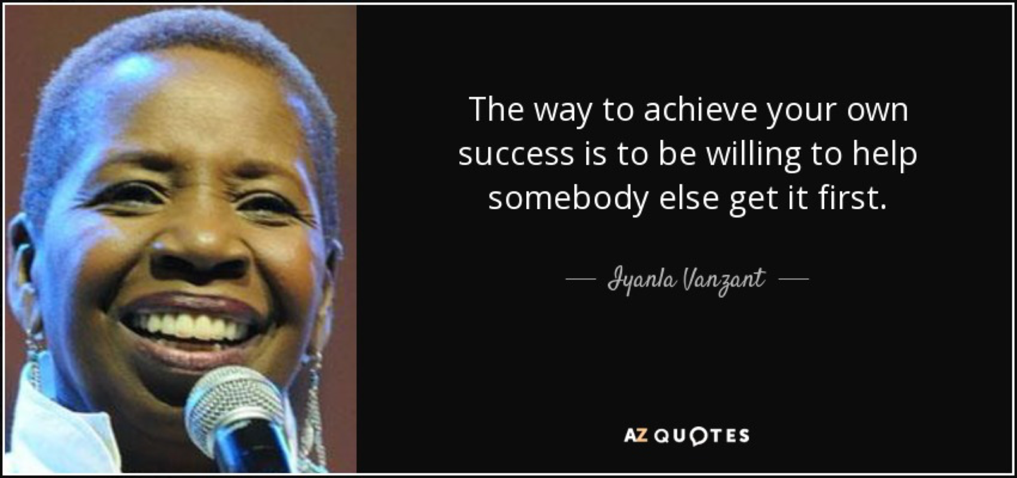

Slide 13
Negotiation Styles
Notes:
Most people negotiate based on two parameters – the relative importance they place on the substantive outcome (concern for self) of the negotiation and their relationship with the other party (concern for others).
Bargaining & moving

Slide 14
Never concede without concession
Notes:
Which means offer only. “what if….” then would you….

Slide 15
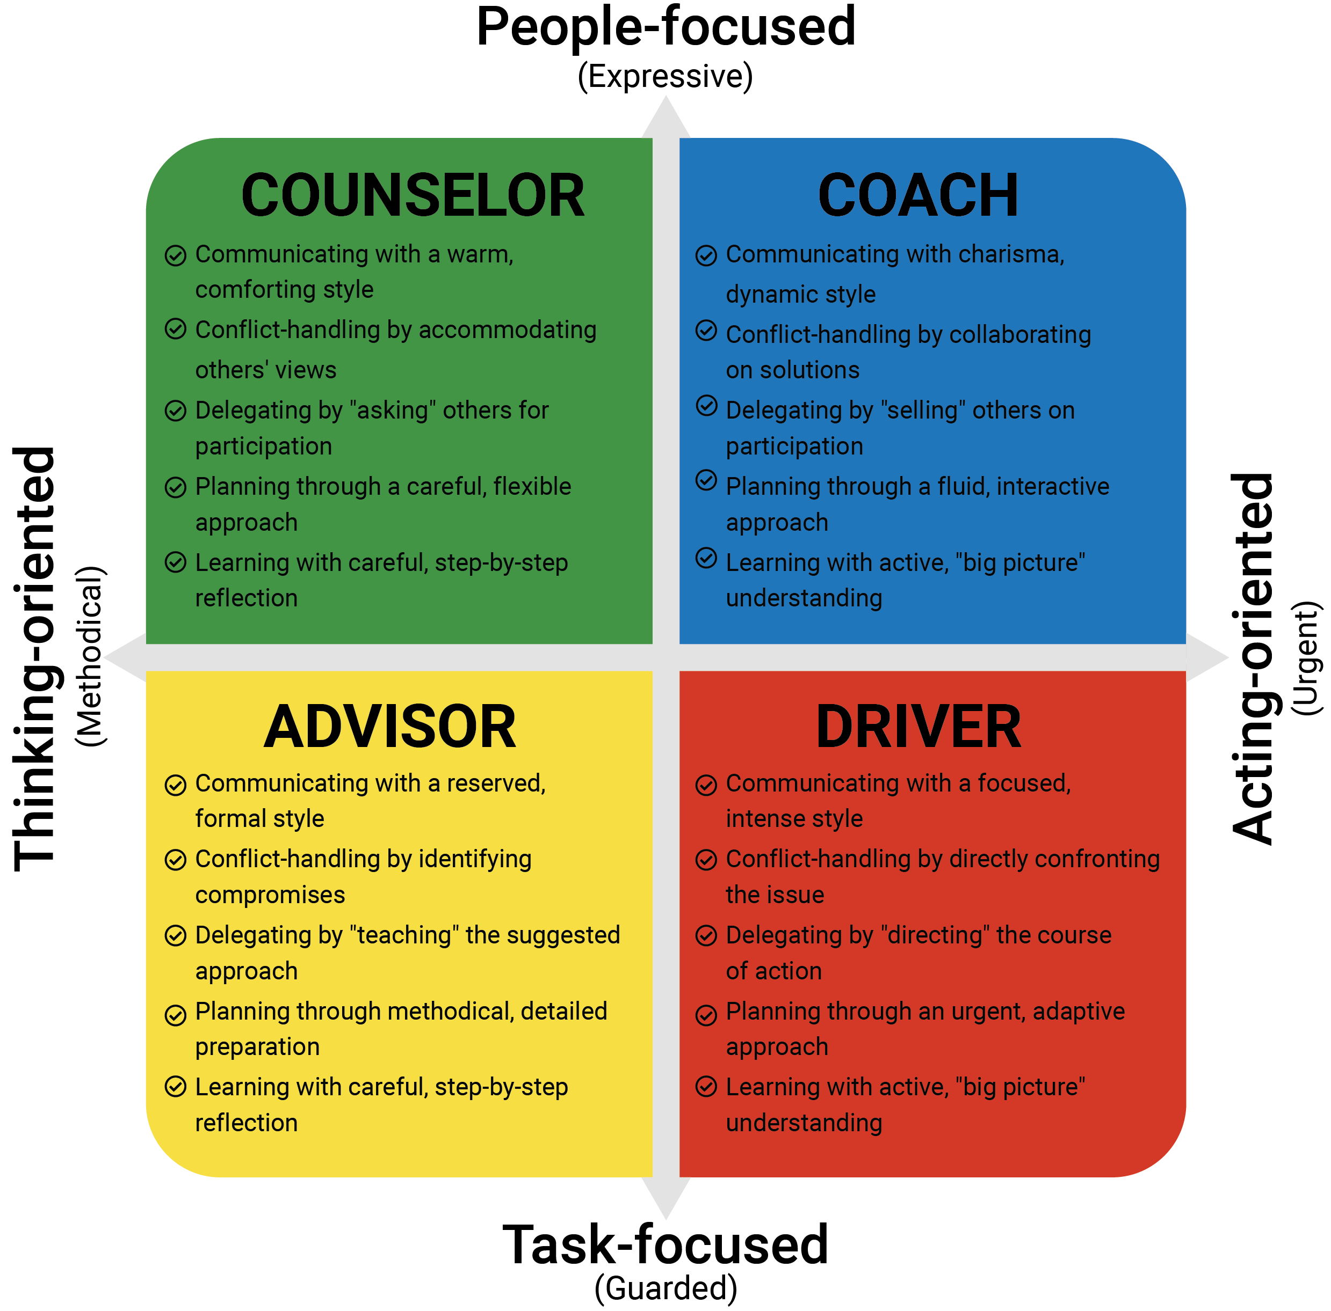
Communication Style

Slide 16
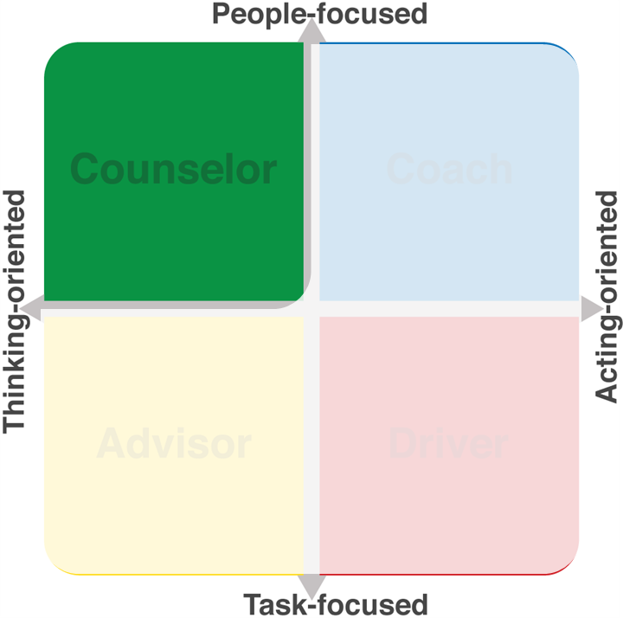
Profile Interactions
Try to:
Build genuine rapport
Affirm what you hear
Recognise personal interests
Avoid:
Rushing the conversation
Using an impersonal tone
Overlooking their concerns
Notes:
Section 5 of the report on page 7 provides information on how to stretch or mirror other profiles to improve interactions.
When you do so, you grow your influence over others. We will explore influencing later in the program.
Let’s firstly have a look at the Counselor.
For those Counselors in the group, is there anything else you would add to either list?

Slide 17
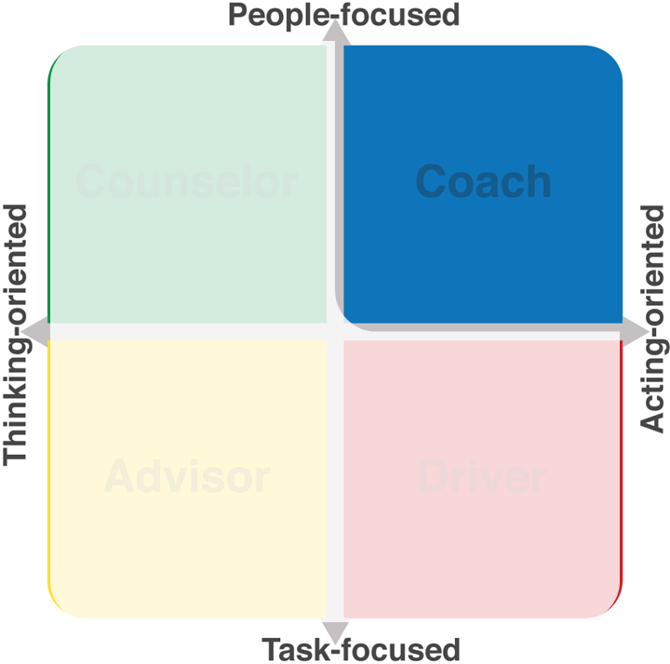
Profile Interactions
Try to:
Focus on the big picture
Emphasise impact on people
Encourage brainstorming
Avoid:
Sharing unnecessary details
Limiting their feedback
Using an impersonal tone
Notes:
Next let’s look at the Coach.
For those Coaches in the group, is there anything else you would add to either list?

Slide 18
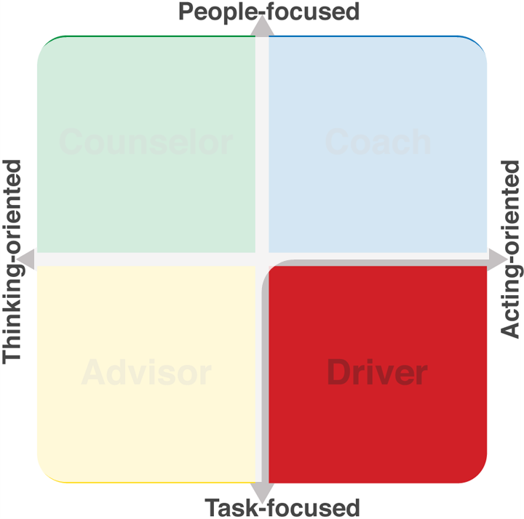
Profile Interactions
Try to:
Focus on the bottom line
Emphasise results
Be clear and specific
Avoid:
Forcing personal small-talk
Controlling the conversation
Challenging their position
Notes:
Next we’ll take a look at the Driver.
For those Drivers in the group, is there anything else you would add to either list?

Slide 19
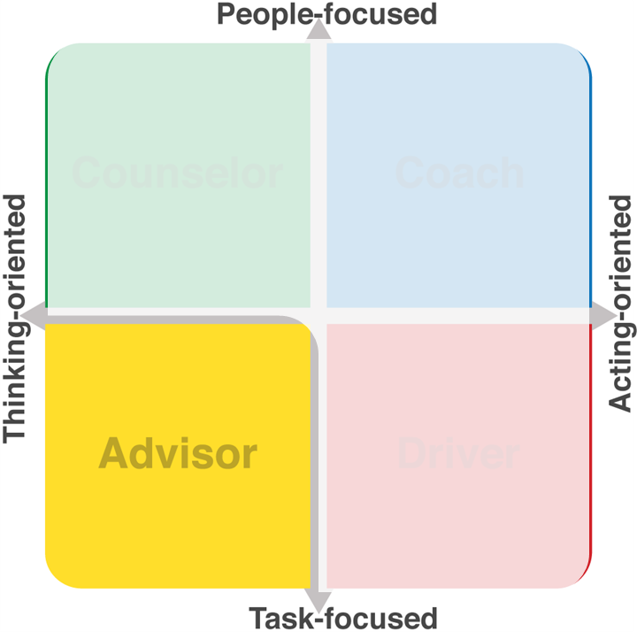
Profile Interactions
Try to:
Focus on the details
Emphasise logic and rationale
Draw out specific concerns
Avoid:
Using emotional arguments
Offering vague expectations
Pushing for a conclusion
Notes:
Next look at the Advisor.
For those Advisors in the group, is there anything else you would add to either list?

Slide 20
The Negotiation Process
Preparation
Opening Position
Bargaining
Movement
Closing
Notes:
Preparation:
Identify your key commitments
Opening Position:
Outline Your Opening Position
Decide whether this will be High Ball or Low Ball
Ensure that this position is realistic in light of the facts available to both sides
Allow for movement within whatever opening position you adopt
Confirm all agreements reached and positions offered
Bargaining
Question for Information
Challenge other side for justifications of their position
Examine and Test their commitment
Present Your Key Commitments
Explore Key Commitments
Summarise Arguments and Seek Acceptance
Look for Signals of Possible Movement
Identify and Highlight Common Ground
Movement
Be Prepared to Concede
Begin with those of Low Priority and seek High Priority Items
Never Concede on More than possible by your Brief
Use your Concessions Wisely
Don’t just give these away expect and receive something in return
Use Conditional Argument
All Movement Should be realistic and contained within your brief
It Should be always towards the other sides position and not away from it
Be prepared for larger movements at first as it can build trust within the negotiation
Continue with smaller movements
Closing
Emphasise the benefits to both parties
Carefully introduce the consequences of not reaching agreement to both parties and losing what has been agreed so far
Timing is Essential
Take Care when making a Final Offer. Be sure that it is consistent with your brief.
A Small Traded Offer is often better. A small move by them in return for an extra movement by you.
Ensure that all agreements are understood and accepted before finalization
This should be well documented and signed at the close of the negotiations
These should be then forwarded to both parties post negotiations

Slide 21
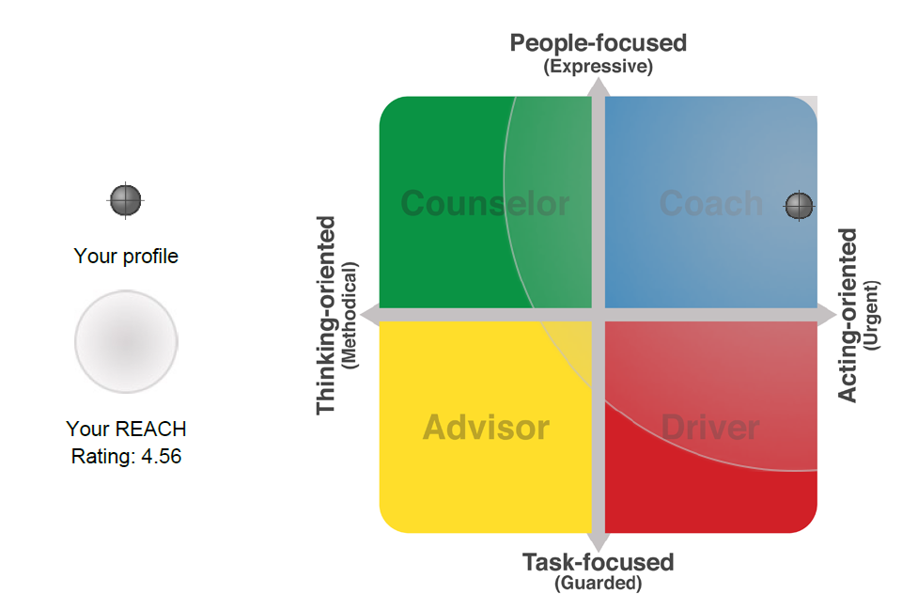
Discover your REACH
Special price for PMI
$165 $95 +GST

Slide 22
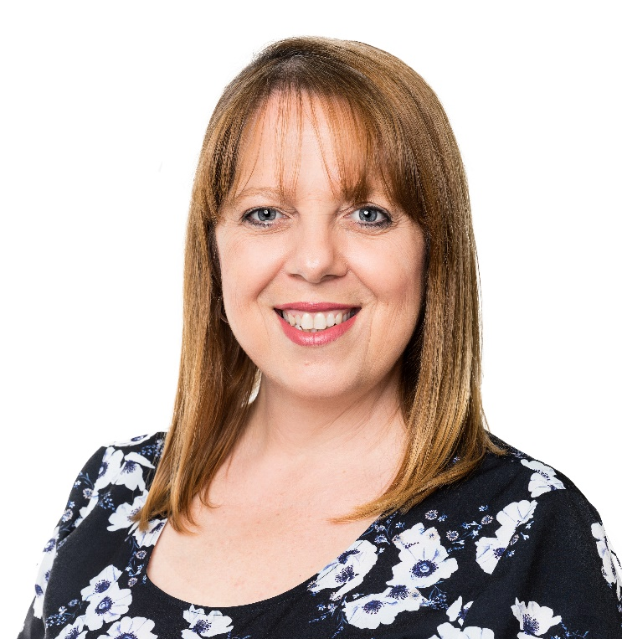
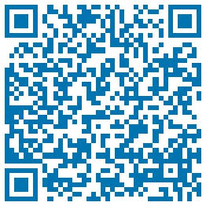
Think more, Do more, Feel more
The Enterprise Trainer
Contact
E: Gina.brooks@trainingxdesign.com.au
P: 1300 662 907
Book me for a Virtual Coffee
https://calendly.com/training-x-design/15min
ginabrooks

Slide 23
Q & A

Slide 24
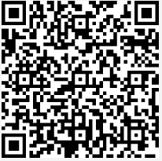
Thankyou to Gina and to all of you who have attend this evening. To help us improve our events, please complete this survey We hope to see you at our next event

