Slide 1
PMI Adelaide, South Australia Chapter
Presents
Annual General Meeting and Presentation on Authentic Leadership
Tuesday 21/03/2023

Slide 2
Acknowledgment of the Land
We would like to acknowledge the Kaurna People of whose land we meet on today.
We also pay respects to their Elders past and present and extend that respect to other Aboriginal and Torrens Strait Islander people, if present, here today.

Slide 3
Agenda
Registration and Networking (Including drinks & nibbles) | 5:00 pm to 6:00 pm
Welcome and Introductions | 6:00 pm to 6:10 pm
AGM and Q&A | 6:10 pm – 7:00 pm
Guest Presenter – Mike Roberts, Millpond | 7.05 pm to 7:55 pm
Q&A for Mike Roberts | 7:55 pm – 8:05 pm
Event Close | 8:15 PM

Slide 4
PMI Adelaide, SA Chapter
Run by volunteers, we provide the means for members to meet with peers from various industries and improve their project knowledge and skills through events, special workshops, marketing, newsletter publications and an annual project management conference.
2003
12
Established
Number of events per annum
+310
~10,000
PMI Adelaide Members
Members Across Australia
+2660
Number of LinkedIn followers
Interested in becoming a Chapter volunteer – hossein.mohsenian@pmiadelaide.org
4

Slide 5
Welcome to Our new Members
New Members
Steve Bosnakis
Amir Zolfaghar
Uditha Rajasekara
Leora S’Douza
Sarah Batge
Abigail Blanca Pena
Diego Beltran Barragan
Muruganantham Ravichandran
Shalini Alexander
Liancheng Li
Aviral Singh
Uchral Erdene

Slide 6
Upcoming Events
May 2023 – Major SA Project Case Study Presentation
May 2023 – Strategy Workshop sponsored by BDO
June 2023 – Beer & Brains Networking
July 2023 – Women in Projects sponsored by BDO
For more PMI Adelaide Chapter events visit our website: www.pmiadelaide.org
Follow PMI Adelaide socials on:
LinkedIn - https://au.linkedin.com/company/pmi-adelaide-south-australia
Instagram – @pmiadelaide
Facebook – https://www.facebook.com/pmiadelaide
Interested in speaking at a PMI Adelaide Chapter event. Email: events@pmiadelaide.org

Slide 7
Interested in becoming a Chapter partner or Sponsor - peterpavan@pmiadelaide.org

Slide 8
2023 ANNUAL GENERAL MEETING

Slide 9
CHAPTER VS 2022 STRATEGIC OBJECTIVES
Enhance Awareness and understanding of PMI brand across SA Community
Increase Breath & Depth of Local Partnerships
Have members at the heart of everything we do
Broaden our Reach
Deepen our Impact
Nurture Lasting Relationships
CHAPTER
PMI GLOBAL

Slide 10
2022 Areas of Focus (Strategy)
BUILDING AWARENESS
LOCAL PARTNERSHIPS
MEMBERSHIP FOCUS
Explore Interest with Business SA for Regional Events
Explore Opportunities to Partner with Universities
Hold an Industry Engagement Parley to offer services and identify opportunity for Partnerships
Explore opportunities to partner with Academia and Business to get Quality Speakers which attract more stakeholders
Create Cross Chapter Forum where certain chapter events can be advertised and done online.
Board Meetings to focus on these Areas while Operational Functions are taken care of by the CEO and His leadership Team
Explore Opportunities For Special Projects that achieve this objective through partnership with Industry or Community
Secure Event Sponsors for at least 50% of our events and 2-3 Chapter Sponsors contributing $5000.
Recruitment of more Volunteers to help with existing and new initiatives that drive local partnerships
Explore opportunities to provide content that help project managers grow their skills and knowledge
Explore Opportunity to Expand Mentorship Program to Other States
Regular feedback from mentees and mentors
Feedback from training participants
Post Event Surveys
Develop Communications Plan to Improve Communication with Members and Local Community
Personal Call to Members to Keep them Involved after Emails

Slide 11
2022 Achievements
Updated by-laws including new board structure
Election of board members in the new structure
Appointment of operations executive team in the new structure
Delivery of 12 events & presentations
As well as Beer & Brains networking events
A founding society and delivery partner of Adelaide Connected 6
Chapter representation at
PMI Australia & New Zealand (Region 10) Conference in Sydney
PMI Asia Pacific Leadership Institute Meeting (LIM) in Singapore
PMI Global Summit in Las Vegas
Reached 2500+ LinkedIn Followers

Slide 12
2022 Financials
Member subscriptions | $23,731
Event Fees Received (Non Member) | $5,294
Chapter Sponsorship | $9,451
Adelaide Connected Sponsorship | $21,901
Interest received | $16
Other revenue (Mentoring etc) | $360
Income *- $60,851
Bank - $88,275
Net Profit AFTER Tax 2021/22 $1,756
Tax return $1,447
* Income includes $21,901 from sponsorship from Adelaide Connected in 2021

Slide 13
2022 Financials
Accountancy fees | $4,267
Marketing | $1,419
Bank charges | $50
Team Building/ Meetings | $0
Conference expenses | $1,562
Event expenses | $26,900
Adelaide Connected | $15,369
Printing and stationery | $198
Speaker fees, gifts & donations | $0
Subscriptions (O365, mentorink, website): | $4,434
Traveling Expenses: | $2,227
Expense* ($56,427)
*includes Adelaide Connected Income $15,369

Slide 14
PMI Adelaide Strategy 2023 - 2027
February 2023

Slide 15
Vision STATEMENT (SAME) Our Chapter is the most advanced PM community in South Australia.
MISSION STATEMENT (NEW)
To empower Project Managers of all levels, related professionals and organisations with the opportunity to accelerate their productivity and
success by enabling learning from others in the community and making a significant impact in South Australia

Slide 16
PMI Global Strategic Objectives
These objectives align our community in a common direction, allowing us to shape the future – together.
Broaden our Reach
Empower the PMI Community to share our collective wealth of knowledge with new people who need it.
Deepen our Impact
Have a profound impact on people’s lives and EMPOWER THEM to make their ideas a reality.
Nurture Lasting Relationships
Cultivate deep, trusting relationships with people and organizations who share our aspiration.
Notes:
Our PMI Impact Strategy can be summarized in three Strategic Objectives. These objectives aim to be simple, powerful directors for the entire PMI community. A guiding star to point us all in the same direction as we grow and expand our collective impact.​
Everything we do should level up to one or more of these objectives, including the efforts of PMI staff, contractors, Global Volunteer Leaders, and Chapter Leaders.
Each of us should be able to draw clear connections between our daily work and these objectives, and we should carefully re-consider the value of initiatives that don’t appear to support them.

Slide 17
Broaden Our Reach – Strategic Goals
Strategic Goals
Develop PMI services that align with the needs of our members and partners by mapping PMI Adelaide services and updating them, considering the members’ and partners’ feedback.
Activities and KPI’s
Develop PMI services mapping by December 2023
Increase membership numbers:
Run 1 major PMI event per year to build visibility and recognition (more than 200 people)
Increase PMI Adelaide social media numbers by 10% per platform per year
Individual members by 10% per year
Company memberships (defined as an organisation which pays for 5 or more members) by 5 new per year
Build associations with senior PM leaders, organisations, and government by sending Directors and associate directors to participate in other groups’ activities and relevant events
Grow membership numbers (including all levels, such as students, Senior Managers and etc.) and increase PMI Adelaide’s visibility by creating a marketing plan
Directors and Associate Directors to attend at least one activity or relevant event from other organisations per year
Create a full marketing plan by June 2023

Slide 18
Deepen Our Impact – Strategic Goals
Strategic Goals
Increase volunteer numbers and engagement with PMI and delivering a social impact
Activities and KPI’s
Develop additional volunteer opportunities for PMI members and increase volunteer numbers by 10% per year
Increase sponsorships and partners (including government)
Leverage PMI global reach & relationships
Build Scalable services and support mechanisms.
Add one new support product\service to the PMI service mapping per year
Increase PMI Adelaide’s representation at PMI Global and APAC
Double the number of partners\sponsors per year
Introduce PMI Global in our events at least once per year
Introduce social impact programs or projects
Introduce at least one social impact program or project that provides a positive effect on a community or not-for-profit by 2025

Slide 19
Nurture Lasting Relationships – Strategic Goals
Strategic Goals
Build long-lasting relationships with associations to develop strategic opportunities.
Activities and KPI’s
Establish formal/informal relationships with 2 strategic associations per year.
Develop Project Management skills, knowledge and career opportunities for all members and associated organisations.
Measure PMI Adelaide Member recognition of the value of PMI Adelaide professional development and career advancement once a year.
Facilitate awards with educational members and other organisations to integrate them into the PMI project management recognition.
Create a student award (combining the relevant education institutions), a professional and organisation awards by 2024.

Slide 20
2023 Annual Plan Highlights

Slide 21
2023 Events Plan
Q1 Jan - Mar
AGM with Leadership Speaker
Uni Mentoring
Q2 Apr – Jun
Q3 July - Sept
Q4 Oct - Dec
Beer and Brains
Case Study
Presentation
PMI Adelaide 20th Anniversary
NFP – Day of Service
Tour and Presentation Tonsley
Strategy Workshop
Women In Projects Presentation & Panel Discussion
Beers & Brains – Intl Project Mgt. Day
Beer and Brains
Panel Discussion including other Professional Associations
EOY Event
PMI Adelaide will also be involved in Adelaide Connected 7.0 in Q4

Slide 22
Q & A

Slide 23
Authentic Leadership
Be yourself...or if that doesn’t work, be the person your team needs you to be!

Slide 24
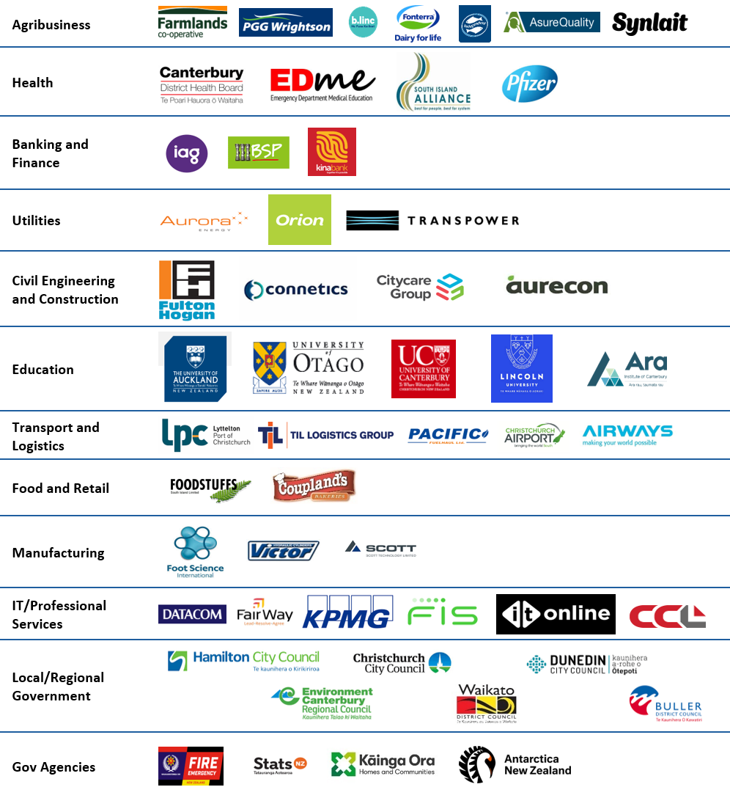
DELIVERY | CONSULTING | TRAINING
Notes:
Millpond is all about projects and helping organisations to do them better.
We provide training, consultancy and delivery services throughout the project lifecycle.
We partner with organisations to increase capability and performance.
We’re a team of 22 spread across Australasia.

Slide 25
Our Training Services
Introductory Courses
Tailored Training
Project Management
Change Management
People Management
Custom built training and content, targeted for your organisation.
Certification Preparation
Certified Associate in Project
Management (CAPM)®
PMI-Agile Certified Practitioner (PMI-ACP)®
Project Management Professional (PMP)®
Disciplined Agile (DA)® (DASM + DASSM)
Mentoring and Coaching
Personal professional development
Chapter Partners
Ensure you are trained:
By an organization, you can trust
With high-quality PMI-developed course content
By PMI-approved, -vetted and –trained instructors

Slide 26
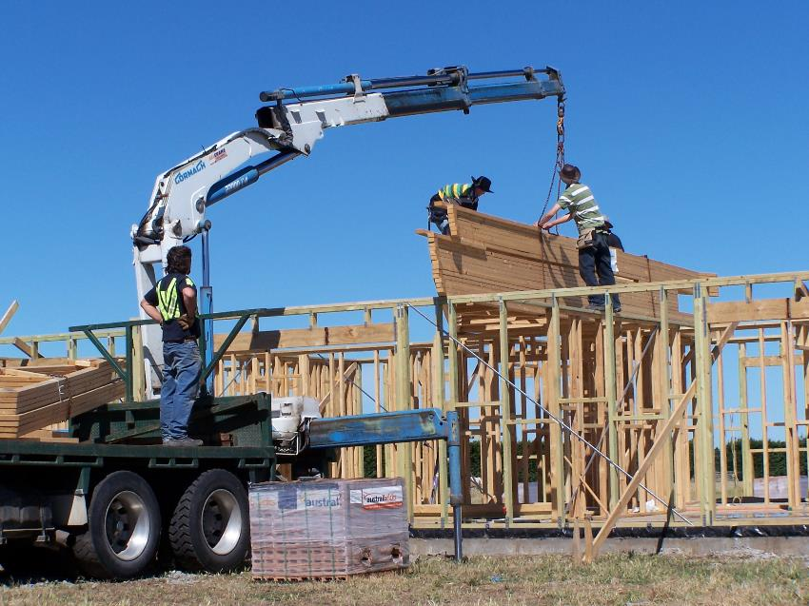
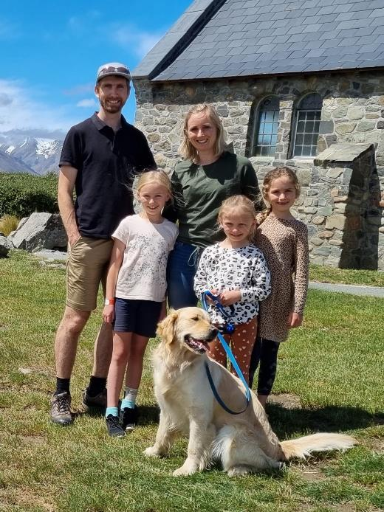
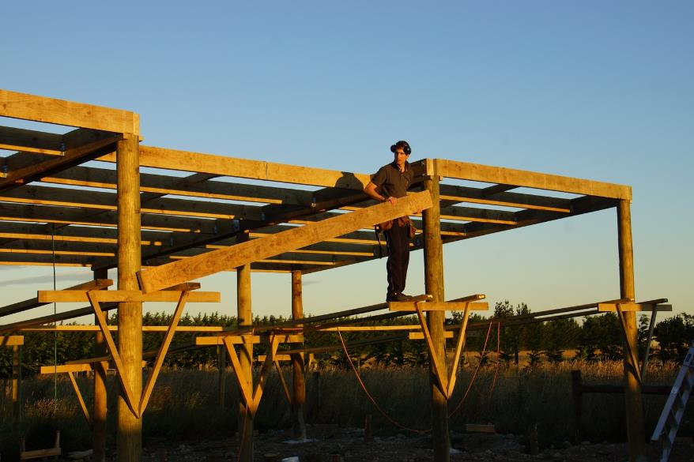
Mike Roberts
PMP®, CAPM®, PMI-ACP®, BICT, GDipPM
Experience – Teaching and Practicing
Volunteering
Personal Interests
Family
Contact me:
mike@millpond.co.nz
linkedin.com/in/mikeroberts/
+64 27 365 7550

Slide 27
1x Free Registration 2023 PMP Live Virtual Training Course Valued at $1,999
https://forms.office.com/r/QwPMxYVjby

Slide 28
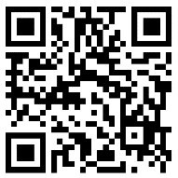
Authentic Leadership

Slide 30
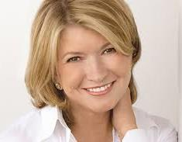
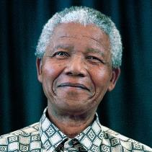
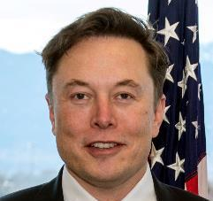
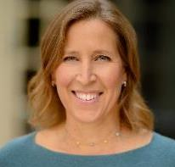
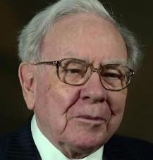
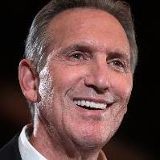
Leadership styles
Autocratic
Makes decisions for the team
Democratic
Team makes the decisions
Collaborative
Transformational
Inspirational
Servant
Laissez-Faire
Transactional
Command and control
Creativity and innovation
Support and empowers the team
Team needs first
Minimal guidance/direction
Hand off - trust of the team
Clear targets
Reward or punishment
Martha Stewart
Nelson Mandela
Elon Musk
Susan Wojcicki
Warren Buffet
Howard Schultz
Notes:
Susan Wojiski / Wogiski

Slide 31
Leadership styles
Tuckman’s stages of Team Development
Leadership Style
Autocratic
Directing Leader
Performing
Coaching Leader
Norming
Facilitating Leader
Participative
Storming
Forming
Supporting Leader
Early Phases
Late Phases
Project Timeline
Notes:
Susan Wojiski / Wogiski

Slide 32
Authentic Leadership
Authentic leadership is not a specific leadership style, but rather a set of characteristics and behaviors that can be applied to any leadership style.
It emphasizes the leader's transparent personality, ethics, and values.
Authentic leaders;
are self-aware
are genuine,
inspire commitment and loyalty, and
are dependable
“Be yourself, everyone else is already taken.”
- Oscar Wilde

Slide 33
Why is it important?
Open communication with and feedback from the team.
Team members feel comfortable expressing their ideas and opinions.
Enhances engagement and builds trust.
Leading to more (+20%) efficient teams.
Leader behaviours do not deviate from what the team expect from them.
Authentic Leadership is the single strongest predictor of an employee's job satisfaction, organizational commitment, and workplace happiness.
- Leadership & Organization Development Journal 27 (2006)
Notes:
Builds trust: Authentic leaders are more likely to gain the trust of their followers. When leaders behave in a way that is consistent with their values, it creates a sense of integrity and credibility. This trust can lead to increased loyalty and commitment from employees.
Fosters openness: Authentic leaders encourage open communication and feedback from their employees. They create an environment where employees feel comfortable expressing their ideas and opinions, which can lead to more creativity and innovation.
Promotes accountability: Authentic leaders take responsibility for their actions and decisions. They hold themselves accountable for their mistakes and take steps to correct them. This behavior sets an example for their employees to do the same, which can lead to a culture of accountability within the organization.
Enhances engagement: Authentic leaders are more likely to inspire and motivate their employees. When leaders are true to themselves, it creates a sense of purpose and meaning for their employees. This can lead to higher levels of engagement and job satisfaction.
Increases effectiveness: Authentic leaders are more effective in their roles. When leaders are transparent, honest, and consistent, they can build stronger relationships with their employees. This can lead to better collaboration, decision-making, and overall performance.
In summary, being an authentic leader can lead to increased trust, openness, accountability, engagement, and effectiveness within an organization.
People want leaders they can connect with who understand them. They seek leaders they can relate to. In other words, we want leaders who are like us but a little further down the path.
People don’t like having mixed messages
People don’t want a leader who will flip their lid
First and foremost, it distracts your amazingly talented employees from doing what they do best — their work.

Slide 34
When things don’t go well, being an Authentic Leader will set you up with a good strong relationship
as a foundation to work from.

Slide 35
How do I become an Authentic Leader?
The bad news:
It takes time and is an ongoing process that requires continuous reflection, self-awareness, and a commitment to growth.
The good news:
It’s a simple 4 step process!
Step 1: Get to know yourself
Step 2: Live your values
Step 3: Build strong relationships
Step 4: Continuous learning and growth

Slide 36
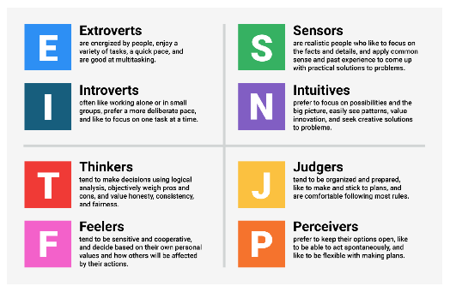
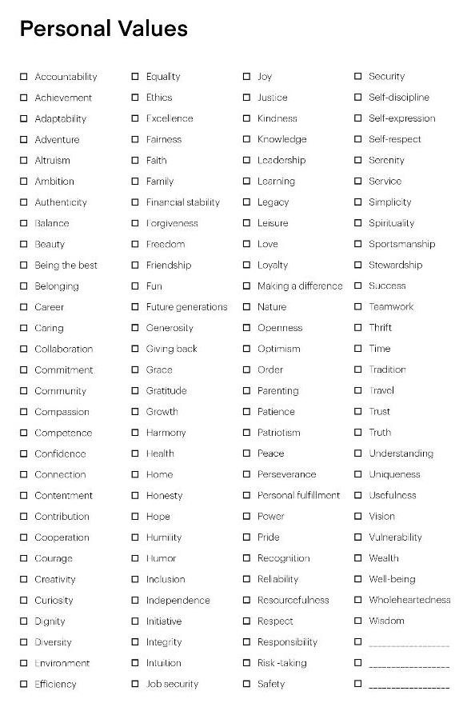
Step 1: Take a step back and get to know yourself.
Personality Profile
Understand your strengths and weaknesses
Personal Values Assessment
what resonates with you?
Ask colleagues for feedback
how are you perceived?
OCEAN Personality
Open to experience
Conscientiousness
Extroversion
Agreeableness
Neuroticism

Slide 37
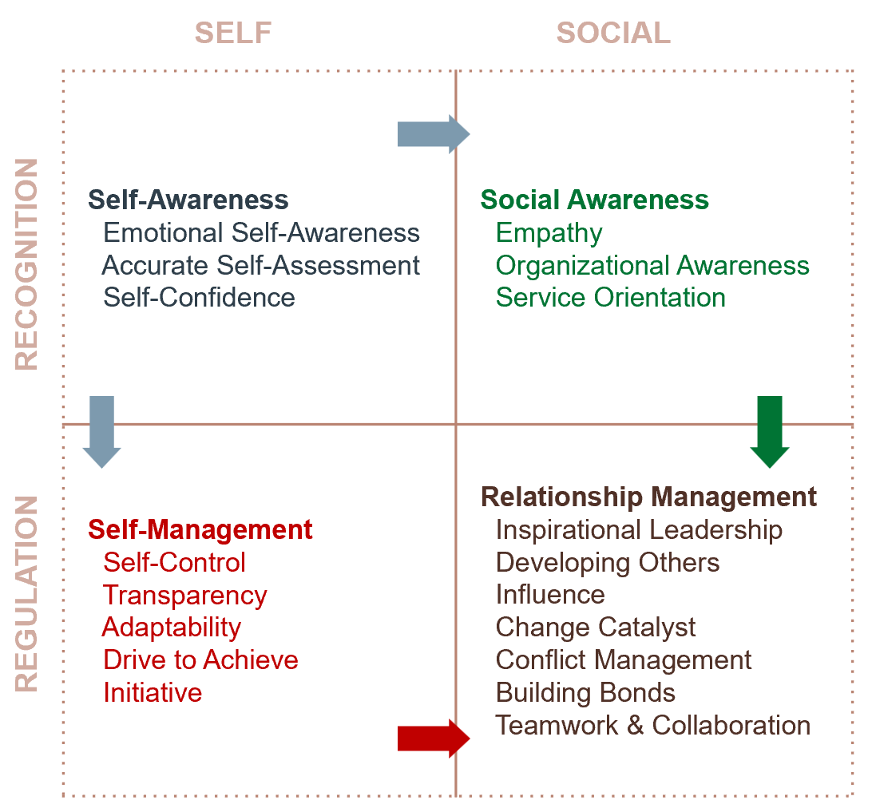
Step 1: Take a step back and get to know yourself.
What is your Emotional Intelligence (EQ) like?
Free Test
Global Leadership Foundation
You may need to work on this if you;
have low confidence
are easily intimidated
are quick to get frustrated
let your emotions drive your actions
act before understanding

Slide 38
Step 2: Live your values
Align your actions and behaviour with your values.
Observe yourself;
Will be easier in a ‘safe’ environment.
Can be challenging in difficult/stressful situations.
Learning
Teamwork/Collaboration
Excitement
Fun
Positivity
Achievement
Motivated
Resilient (handles stress)
Trustworthy
Communication
Friendly
Reliable/Responsible
What people see?
My Values

Slide 39
Step 3: Build strong relationships
Leadership needs Trust.
Trust can’t be dictated. It has to be built.
Invest time in building meaningful relationships with those around you (Stakeholder Engagement 101?)
“Good leaders are people who are trusted by followers.”
- Colin Powell
Team
Management
Wider Stakeholder Community

Slide 41
Step 3: Build strong relationships
“What do you need from me as part of your role in delivering this project?”
“What do I need from you as part of my role in delivering this project?”
If you give people what they want (or expect) then they will value you.
So you need to find out what this is.

Slide 42
Step 3: Build strong relationships
“Golive before the new season launch”
Understand people’s motivations?
What do you want to happen?
What does success look like?
What frustrates you?
What are you concerned about?
Be Human
Celebrate the wins
Don’t pretend to know everything
Share personal stories
Let people know when you’ve made a mistake
Socialise
…you don’t have to be besties
“We need to get the CFO on board”
“I’m worried about the risk to sales forecasts”
“Things are never done properly, I always have to clean up the mess”
“I don’t want to keep working these long hours”
“We need to ensure our system is secure at all costs – we can’t afford a breach”
“How will we ensure a strong supply of materials”
Notes:
Embrace vulnerability
You don’t need to have all the answers or be right all the time
Authentic leaders are willing to admit when they don't have all the answers and to ask for help when needed. This requires a willingness to be vulnerable and to take risks.

Slide 43
Step 3: Build strong relationships
Don’t be afraid to voice/verbalise your thoughts and emotions.
Explain your thought process/logic/math.
Let people know what you feel, - Use “I” messages;
“I feel frustrated as well, it just doesn’t make sense”
“I’m struggling to work out a solution here, can you help me?
“I need your help to make this problem go away”
Notes:
Show people your math; this means you explain how you came to make a decision. Trust grows when you can openly discuss your thinking process, even when a decision goes against a person’s thoughts on the matter. If there is a sound rationale, then it’s much easier to get a person on board with your thinking.

Slide 44
Step 3: Build strong relationships
Channel your inner Servant Leader…
Delegate/Share power and control
Builds a stronger and more collaborative team culture.
Practice Active Listening
Encourage others to share ideas first.
Listen first, ask/share second. You learn more when others speak than when you speak yourself.
Don’t talk over people.
Remove roadblocks
People like people who make things easier/better for them.
Notes:
Channel your inner Servant Leader
Delegate/Share power and control
Builds a stronger and more collaborative team culture
Practice Active Listening
Encourage others to share ideas first.
Listen first, ask/share second. You learn more when others speak than when you speak yourself.
Gaining a better understanding of others’ suggestions, perspectives, and needs.
Don’t talk over people
Remove roadblocks
People like people who make things easier/better for them

Slide 45
Step 4: Continuous learning and growth
Its an ongoing exercise – like most things!
Look for new/difficult experiences and opportunities for learning.
Check in as your project progresses – things can (and will) change!
The project may go off the rails.
People will join/leave the team.
Be open to feedback and constructive criticism.
Step back from the hustle-bustle of work and reflect;
Ask yourself “how did that go?”, “what was I feeling and how did I react?”
Look around you – do you have any leaders who inspire you? Ask yourself - why is that?
Notes:
Projects will come to an end, so the clock resets.

Slide 46
What makes an inauthentic leader?
Say one thing and do another
Cover up weaknesses
Won’t admit when they are wrong
In a disagreement, they will come across as defensive
Claim other people’s ideas as their own
Use their position as power
If we don’t trust our leaders;
We question their integrity
Don’t look for opportunities to go above and beyond
More likely to assume the worst – negativity bias
https://www.tsw.co.uk/blog/leadership-and-management/authentic-leadership/

Slide 47
Applying Authentic Leadership
To some fairly (familiar?) difficult personalities.

Slide 48
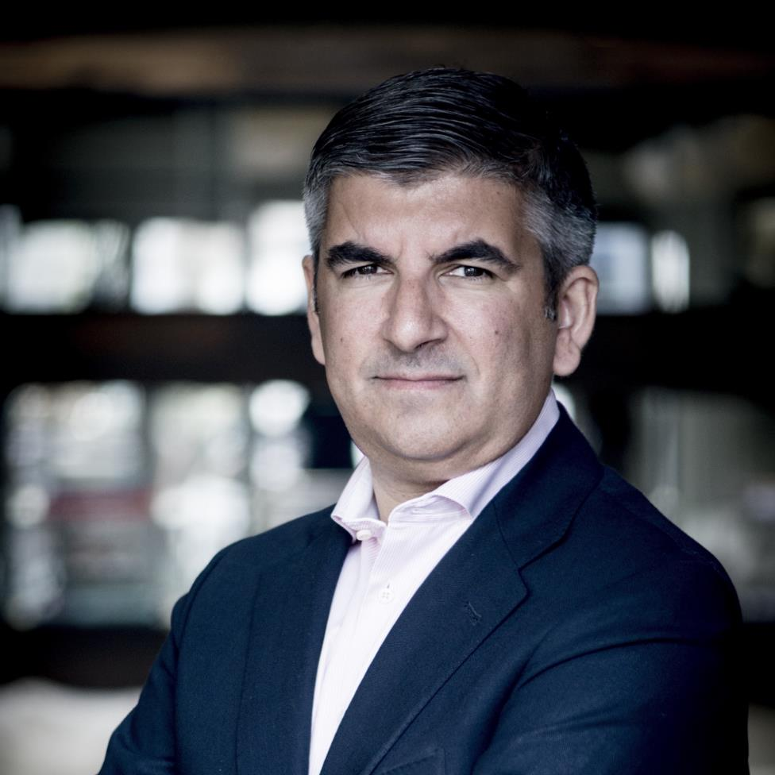
The super serious Sponsor
Characteristics
Is technically very competent.
Always demanding actions/updates;
Always on your toes.
No pleasantries in emails.
Rarely agrees with the team’s views/approach;
Just get it done their way.
Incapable of smiling;
May crack a joke, and expect you to laugh.
Then when you do laugh, you don’t know if it was a joke or not??
Authentic Leadership Approach
Find out what he wants from you.
Give him the time to share his thoughts.
Ask questions, clarify your understanding.
Explain what you/the team think are the risks.
Try avoid being the middle-person between them and the team.
Share the details of the conversation with the team.

Slide 49
The perfectionist Lead Engineer
Characteristics
Their ideas are usually right.
Likes to be involved in all conversations.
Gets to the point that nothing can happen within the project without involving this team member;
The team relies on them.
Gets annoyed at suggestions that do not work or waste time.
Openly voices frustration of management.
Authentic Leadership Approach
Meet with them separately;
Ideally away from their desk/workplace.
Acknowledge the issues they are raising. Clarify what you know.
See what you can do to reduce some of the pain;
Allow extra time for resources to take on duties.
Represent their views to management. Explain the frustration;
In an non-emotive way.

Slide 50
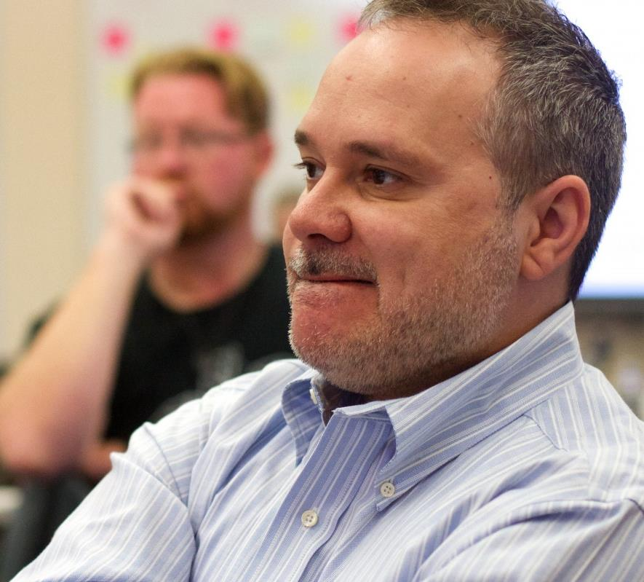
The SME who never has anything positive to say!
Characteristics
Each interaction is usually an expression of negativity;
Raises valid points, but just not in the best way.
Often appears stressed.
Not familiar with the uncertainty of projects.
Focused on the past, when things were stable.
Never completes any of the assigned tasks on time.
Authentic Leadership Approach
Setup regular calls with them and their team.
Share the overall project vision, progress to date, and the immediate next steps.
Acknowledge the current issues;
Ask them to prioritise.
Understand what their key business milestones are;
What has to be operational by when.
Can you work on a backup/contingency plan?

Slide 51
The Technical Specialist who leaves us confused
Characteristics
High IQ, Low EQ
Talks a million miles an hour.
Use jargon which we have little understanding of.
Sends really long emails that no one reads.
Seems to make things more complicated than what they need to be.
Authentic Leadership Approach
Ask them to explain the business purpose/risk;
Repeat it back to confirm your understanding
White board concepts.
Find out who they need to work with and when.
Don’t try to fake your knowledge;
Be honest and explain that you don’t understand, but you really want to.
Don’t talk on their behalf in meetings.

Slide 52
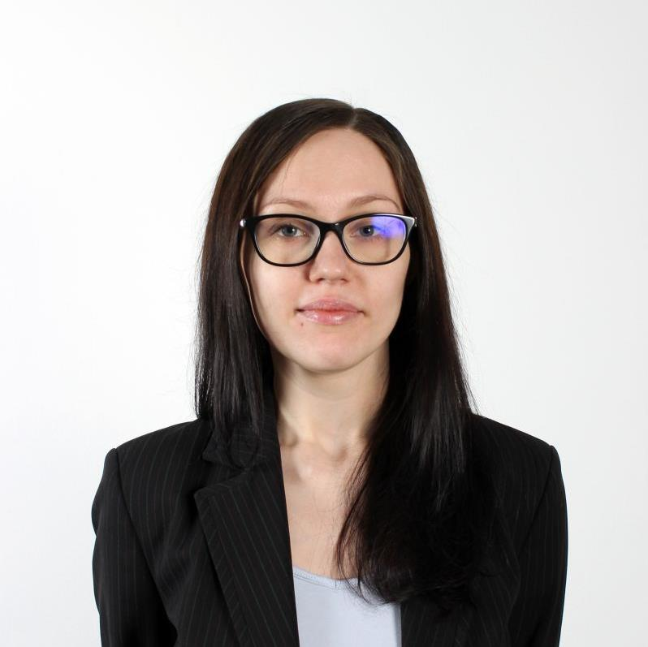
The slightly sensitive Analyst
Characteristics
Is/looks stressed.
Doesn’t contribute often, but when they do, there is good reason for it.
Struggles with too many open tasks.
Likes to have plenty of notice, plans clearly laid out.
Delivers quality output, that you know you can rely on.
Authentic Leadership Approach
Show heart/compassion.
Check in frequently and find ways to support them.
Share the plan – where to next?
Emphasise their workstream
Recognise their efforts;
But ensure you work out how they would like to be recognized.

Slide 53
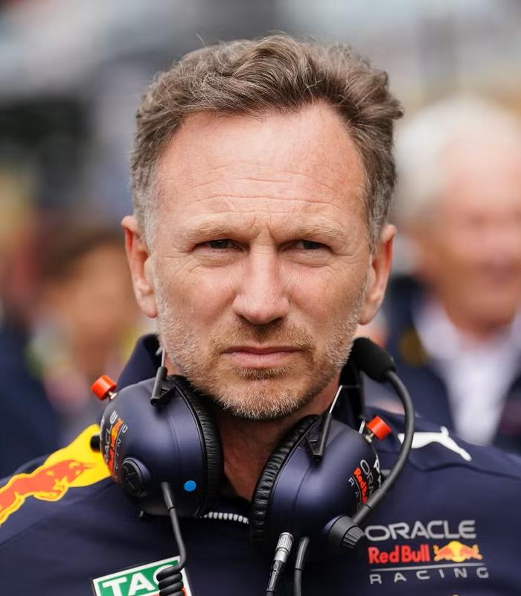
Advice from Christian Horner
“I’ve got to learn about this team, the people, understand its strengths and weaknesses and that is what I set about the next six months doing. Just looking and listening, talking to people, getting to know and understand the business.”
You’ve got to;
Surround yourself with the right people
Empower those people
Be clear on the objectives and what the expectations are
And try to remove the obstacles so they can do their jobs.
-Christian Horner

Slide 55
Be yourself...
or if that doesn’t work, be the person your team needs you to be!

Slide 56
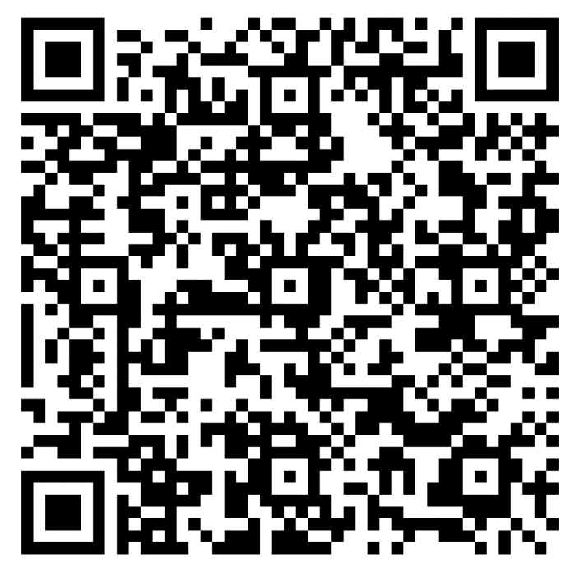
Thank you!
Contact us:
www.millpond.co.nz
info@millpond.co.nz | mike@millpond.co.nz
linkedin.com/in/mikeroberts/
+64 27 365 7550
Bonus offer:
15% off upcoming CAPM/PMP courses
In person: 1 May 23
Virtual: 13 June 23
Code “PMIADE15”
Valid for 14 days from today
Feedback:

Slide 57
Q&A
This event is sponsored by:

Slide 58
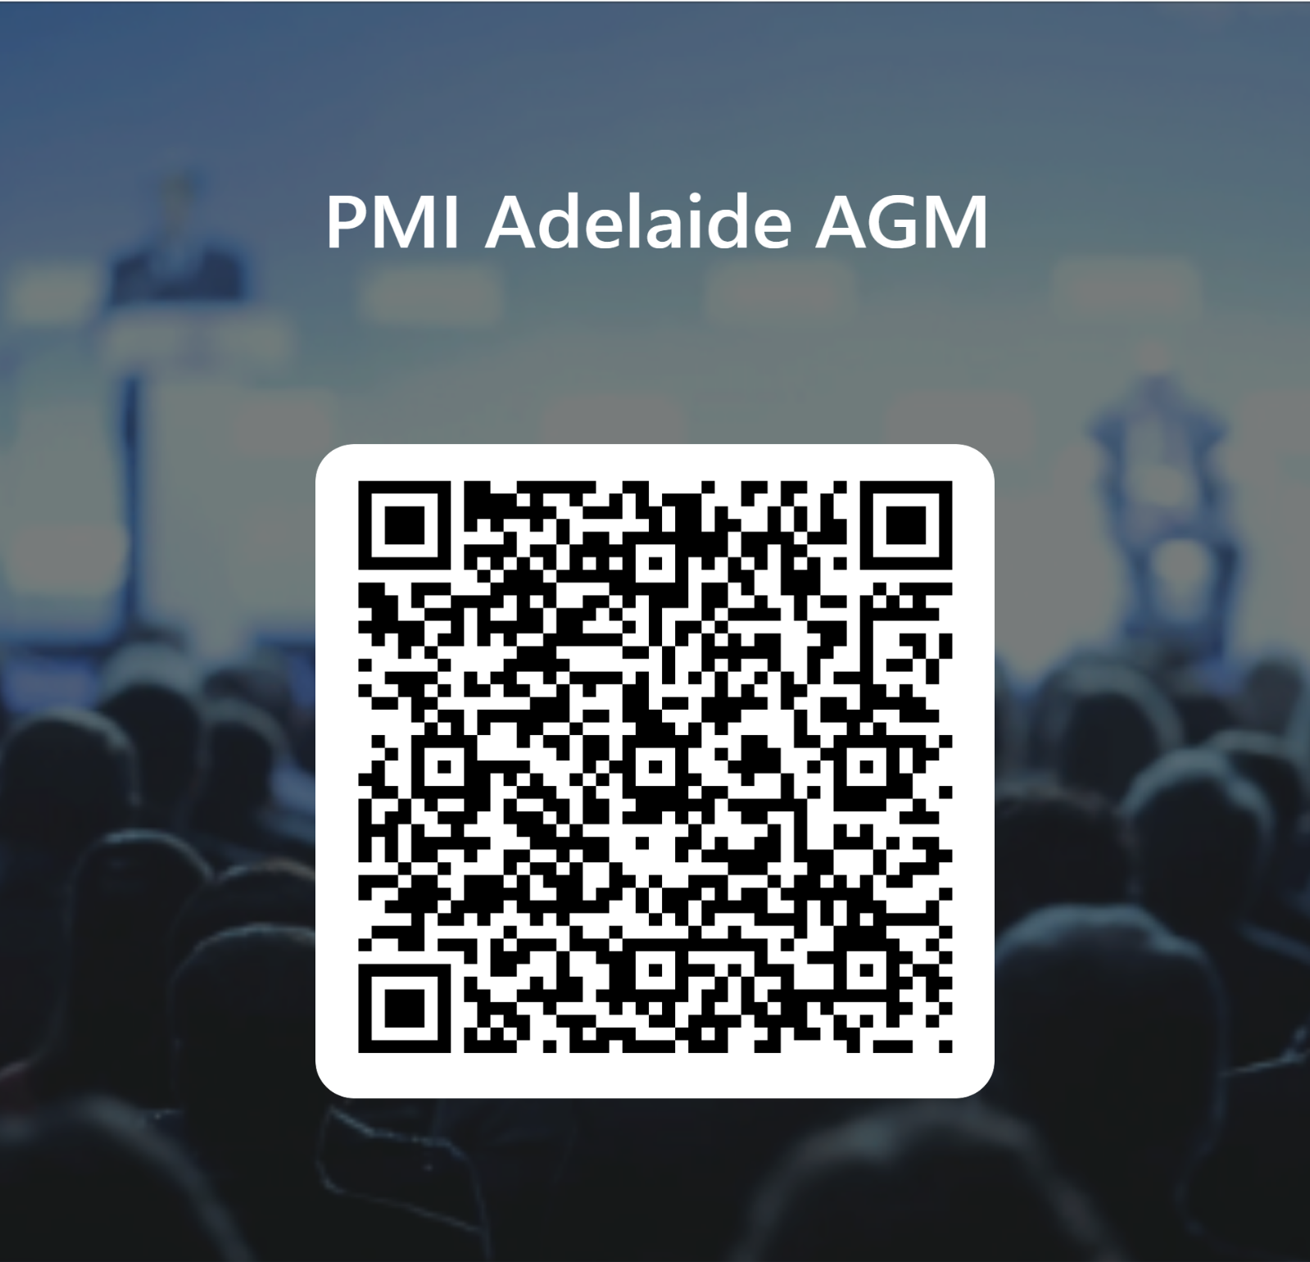
Thank you to our Speaker Mike Roberts and our Event sponsor Millpond and to all of you who have attended this evening. To help us improve our events, please scan the QR code to complete a short survey:
We hope to see you at our next event

Slide 59
Volunteer with us volunteers@pmiadelaide.org

Slide 60
Thank you to all of you who have attend this evening. We hope to see you at our next event

